Slide 1


CMR TECHNiCAL CAMPUS UGC AUTONOMOUS Accredited by NBA & NAAC with A Grade Approved by AICTE, New Delhi and Affiliated to JNTU, Hyderabad
DEPARTMENT OF COMPUTER SCIENCE AND ENGINEERING
MINI PROJECT
ON
PREDICTING THE TOP-N POPULAR VIDEOS VIA CROSS-DOMAIN HYBRID MODEL
UNDER THE GUIDANCE OF :- PRESENTED BY:-
SANJANA NAZARE ROHIT MOON
(Assistant Professor) (177R1A05G4)
MOHAMMAD UMER
(197R1A05Q1)

Slide 2
ABSTRACT
Predicting the performance of popular videos and their future views for a large batch of newly uploaded videos is of great commercial value to online video services (OVSs).
Majorly it is difficult to predict the performance of popular videos.
We propose a novel multifactor differential influence (MFDI) prediction model based on multivariate linear regression (MLR).
By using this we enhance the ability of early view patterns to identify popularity trends.

Slide 3
EXISTING SYSTEM
From the perspective of commercialization, identifying the top-N popular videos services providers to maximize their profits, as advertisers are more likely to pay more for popular videos.
Although prediction of top-N videos contains some disadvantages.

Slide 4
DISADVANTAGES OF EXISTING SYSTEMS
First, popular and unpopular videos may have similar early view patterns, and this similarity limits the performance benefit of video classification based on early view patterns.
Second, existing studies show that the strong correlation between early views and long-term popularity dominates the training of the prediction models.

Slide 5
PROPOSED SYSTEM
We propose a model for predicting the top-N popular videos .By enhancing the ability of early patterns to distinguish among popularity trends.
We evaluate the proposed model using real-world data consisting of videos form YouTube and social network data from twitter.
The most video in OVS system is unpopular. So models learns the popularity trend of unpopular videos to improve their performance.

Slide 6
ADVANTAGES OF PROPOSED SYSTEM
Proposed model outperforms state of art models, there by confirming the benefits of our efforts to improve the prediction performance for the top-N popular videos.
The model is designed to improve discovery of popular videos and their popularity trends.

Slide 7
Hardware requirements
System : Minimum of Intel core i3 processor.
Hard disk : 16 GB
Monitor : 14’ Colour Monitor.
Mouse : Optical Mouse.
RAM : 4 GB

Slide 8
Software Requirements
Operating system : Windows 7 Ultimate.
Coding Language : Python.
Designing : HTML, CSS and JavaScript.
Data Base : MySQL

Slide 9
NOVELTY
The Internet has become one of the primary means of communication and information in the world With the popularization of the Internet, streaming video services, such as YouTube, Netflix, GloboPlay, and Amazon Prime, have also grown.
To take advantage of this new market, major content producers such as Netflix and Amazon Prime have emerged, focusing on video streaming services.
Nevertheless, a tool with this ability would be of great value to help dimension network infrastructure and properly recommend new content to users.

Slide 10
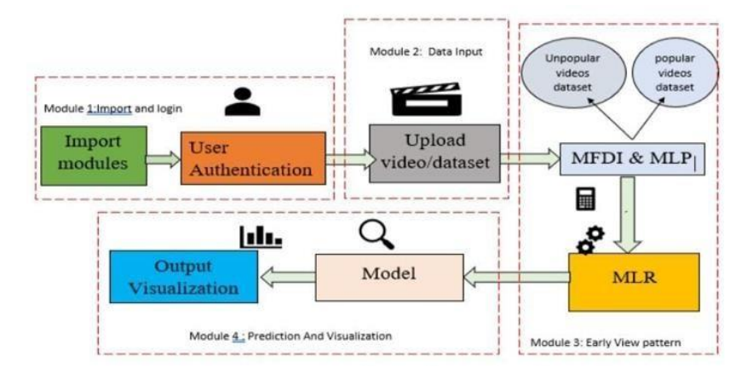
ARCHITECTURE
ARCHITECTURE DIAGRAM

Slide 11
MODULE
UPLOAD VIDEOS
EARLY VIEW VIDEOS
PREDICTING N-POPULAR VIDEOS
ANALYSIS

Slide 12
UML DIAGRAMS

Slide 13
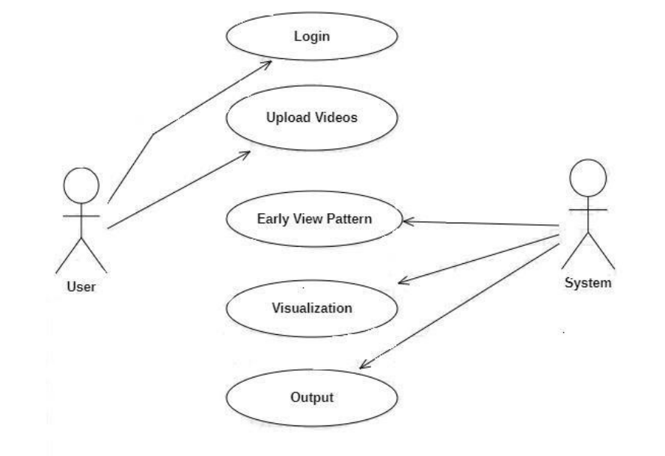
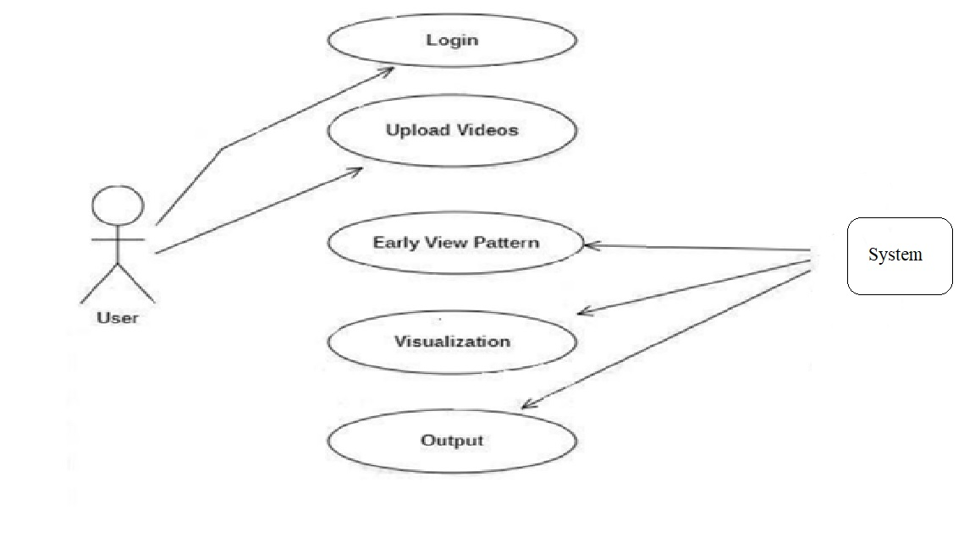
Usecase Diagrams

Slide 14
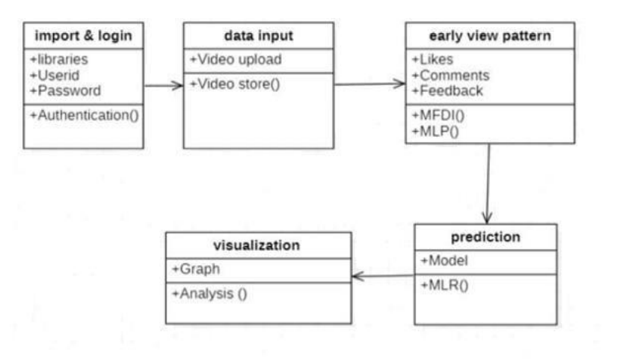
Class Diagrams

Slide 15
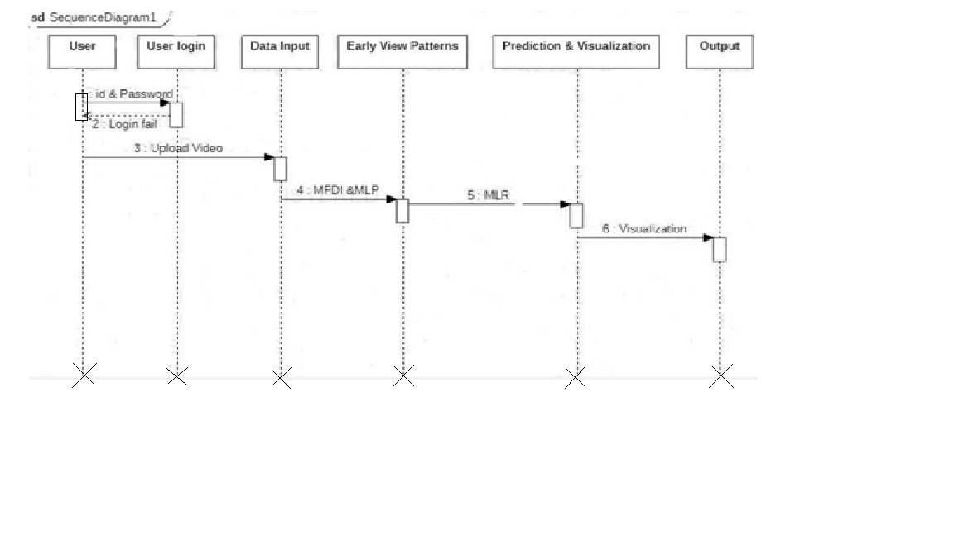
Sequence Diagrams

Slide 16
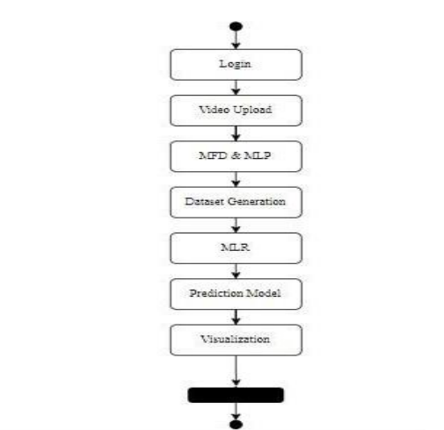
Activity Diagrams

Slide 17
Sample Code
import os import sys
if _name_ == "_main_":
os.environ.setdefault("DJANGO_SETTINGS_MODULE",
"Top_N_Popular_Videos.settings")
try:
from django.core.management import execute_from_command_lineexcept ImportError:
# The above import may fail for some other reason. Ensure that the# issue is really that
Django is missing to avoid masking other
# exceptions on Python 2.
try:
import django except ImportError:
raise ImportError(
"Couldn't import Django. Are you sure it's installed and "
"available on your PYTHONPATH environment variable? Did you ""forget to activate a
virtual environment?"

Slide 18
Sample Code
)
raise execute_from_command_line(sys.argv)
import os
# Build paths inside the project like this: os.path.join(BASE_DIR, ...) BASE_DIR =
os.path.dirname(os.path.dirname(os.path.abspath(_file_))) SECRET_KEY =
'*bu0*tclqayls6+uxx#=g=4(6)6f880a%m!i#+l&ime#-!ed'DEBUG = True
ALLOWED_HOSTS = []
INSTALLED_APPS = [
'django.contrib.admin', 'django.contrib.auth', 'django.contrib.contenttypes’,
'django.contrib.sessions', 'django.contrib.messages', 'django.contrib.staticfiles', 'user',
]
MIDDLEWARE = [
'django.middleware.security.SecurityMiddleware',
'django.contrib.sessions.middleware.SessionMiddleware',
'django.middleware.common.CommonMiddleware'

Slide 19
Sample Code
django.middleware.csrf.CsrfViewMiddleware',
'django.contrib.auth.middleware.AuthenticationMiddleware',
'django.contrib.messages.middleware.MessageMiddleware',
'django.middleware.clickjacking.XFrameOptionsMiddleware',
]
ROOT_URLCONF = 'Top_N_Popular_Videos.urls'
TEMPLATES = [
{
'BACKEND': 'django.template.backends.django.DjangoTemplates','DIRS':
[(os.path.join(BASE_DIR,'assets/templates'))], 'APP_DIRS': True,
'OPTIONS': {
'context_processors': [ 'django.template.context_processors.debug’,
'django.template.context_processors.request', 'django.contrib.auth.context_processors.auth',
'django.contrib.messages.context_processors.messages',

Slide 20
Sample Code
],
},
},
]
WSGI_APPLICATION = 'Top_N_Popular_Videos.wsgi.application'# Database
# https://docs.djangoproject.com/en/1.11/ref/settings/#databases
DATABASES = {
'default': {
'ENGINE': 'django.db.backends.mysql','NAME': 'top_n_videos',
'USER': 'root',
'PASSWORD': '123',
'HOST': '127.0.0.1',
'PORT': '3306',
}
}

Slide 21
Sample Code
# Password validation
# https://docs.djangoproject.com/en/1.11/ref/settings/#auth-password-validators
AUTH_PASSWORD_VALIDATORS = [
{
'NAME':
'django.contrib.auth.password_validation.UserAttributeSimilarityValidator',
},
{
'NAME': 'django.contrib.auth.password_validation.CommonPasswordValidator',
},
{
'NAME': 'django.contrib.auth.password_validation.NumericPasswordValidator’,
},
]
# Internationalization

Slide 22
Sample Code
# https://docs.djangoproject.com/en/1.11/topics/i18n/
LANGUAGE_CODE = 'en-us'LANGUAGE_CODE = 'en-us'
TIME_ZONE = 'UTC'
USE_I18N = True USE_L10N = TrueUSE_TZ = True
# Static files (CSS, JavaScript, Images)
# https://docs.djangoproject.com/en/1.11/howto/static-files/ STATIC_URL = '/static/'
STATICFILES_DIRS=[os.path.join(BASE_DIR,'assets/static')]MEDIA_URL = '/media/'
MEDIA_ROOT = os.path.join(BASE_DIR, 'assets/media')from Top_N_Popular_Videos
importsettings
from user import views as user_viewsurlpatterns = [
re_path(r'^admin/', admin.site.urls), re_path('^$',user_views.index,name="index"),
re_path('user/register', user_views.register, name="register"),
re_path('user/userpage',user_views.userpage,name="userpage"),
re_path('user/view_videos',user_views.view_videos,name="view_videos"),

Slide 23
Sample Code
re_path(r'^particular_videos/(?P<pk>\d+)/$',user_views.particular_videos,name='particul
ar_videos'),
re_path('user/treanding_videos',user_views.treanding_videos,name="treanding_videos"),
re_path('user/mydetails',user_views.mydetails,name="mydetails"),
re_path('user/graphical_page',user_views.graphical_page,name="graphical_page"),
]
if settings.DEBUG:
urlpatterns += static(settings.MEDIA_URL,
Views.py
import datetime
from django.db.models import Count, Sum
from django.shortcuts import render, redirect, get_object_or_404
# Create your views here.
from user.forms import RegisterForms
from user.models import RegisterModel, VideosModel

Slide 24
Sample Code
def index(request):
if request.method=="POST": usid=request.POST.get('username') pswd =
request.POST.get('password')try:
check = RegisterModel.objects.get(userid=usid,password=pswd)
request.session['userid']=check.id
return redirect('view_videos')except:
pass
return render(request,'user/index.html')
def register(request):
if request.method=="POST":
forms=RegisterForms(request.POST)if forms.is_valid()
forms.save()
return redirect('index')
else:
forms=RegisterForms()

Slide 25
Sample Code
return render(request,'user/register.html',{'form':forms})
def userpage(request):
uid = request.session['userid']
request_obj = RegisterModel.objects.get(id=uid)esw=''
esw=request_obj.userida=''
b=''
c=''
myfile=''aaa=''
bbb=''
c1=''
c2=''
c3=''
a=datetime.date.today() b=str(a)
c=b.split('-')c1=c[0] c2=c[1] c3=c[2]
if request.method == "POST" and request.FILES['myfile']:myfile = request.FILES['myfile']

Slide 26
Sample Code
aaa = request.POST.get('topic')
bbb = request.POST.get('des’
VideosModel.objects.create(udid=request_obj,usname=esw,upload_date=b,upload_day=c3,
upload_month=c2,upload_year=c1,video_topic=aaa,video_discriptions=bbb,video_file=myf
ile)
return render(request,'user/userpage.html',{'a':c,'c':c[1]})
def view_videos(request): obj=VideosModel.objects.all()
return render(request,'user/view_videos.html',{'obj':obj})
def particular_videos(request,pk):
vid = VideosModel.objects.get(id=pk)ir=vid.id
cnt=0 vot_count=''tle=0
if request.method == "POST":
vot_count = VideosModel.objects.all().filter(id=ir)for t in vot_count:
cnt=t.like_count
tle=cnt+1

Slide 27
Sample Code
obj = get_object_or_404(VideosModel, id=ir)obj.like_count = tle
obj.save(update_fields=["like_count"])
return render(request,'user/particular_videos.html',{'vid':vid,'te':tle})
def treanding_videos(request):a = datetime.date.today()
b = str(a)
c = b.split('-')
c1 = c[0]c2 = c[1]c3 = c[2]
obj=VideosModel.objects.filter(upload_month=c2).order_by('-like_count')
return
render(request,'user/treanding_videos.html',{'onj':obj})
def mydetails(request):
usid = request.session['userid']
us_id = RegisterModel.objects.get(id=usid)
return render(request,'user/mydetails.html',{'obje':us_id})
def graphical_page(request):a = datetime.date.today() b = str(a)

Slide 28
Sample Code
c = b.split('-')c1 = c[0]
c2 = c[1]c3 = c[2]
chart =
VideosModel.objects.filter(upload_month=c2).values('video_topic').annotate(dcount=Sum('l
ike_count'))[:5]
return render(request,'user/graphical_page.html',{'obj':chart})

Slide 29
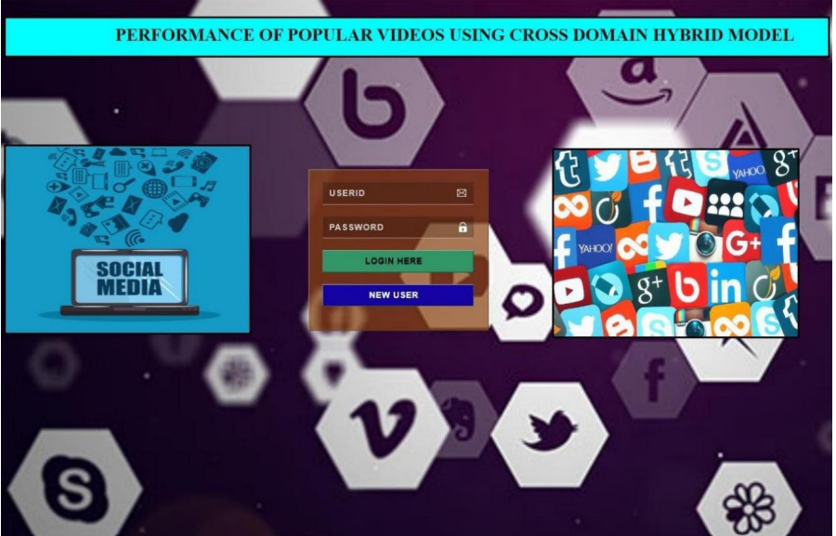
Screenshorts (Results)
Fig 1. User Registration Page

Slide 30
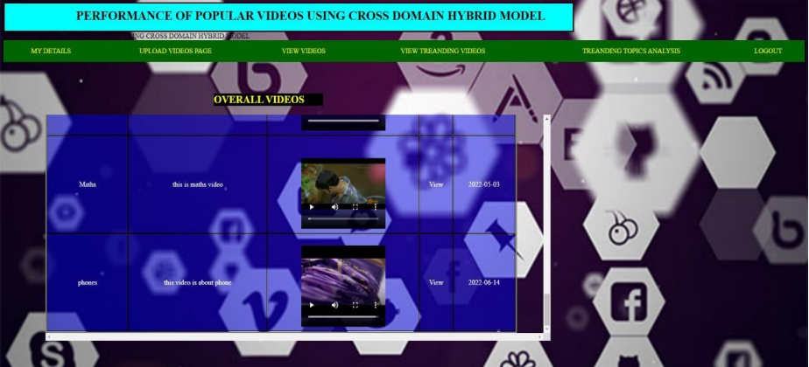
Screenshorts (Results)
Fig 2. Overall Videos Page

Slide 31
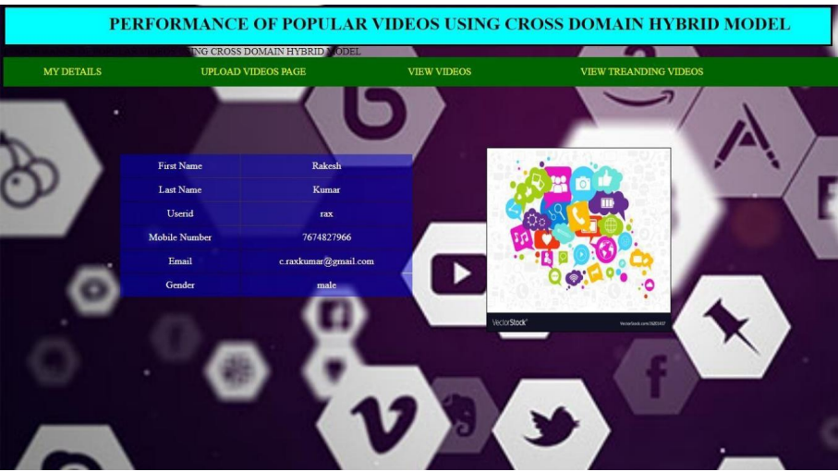
Screenshorts (Results)
Fig 3. Registered User Page

Slide 32
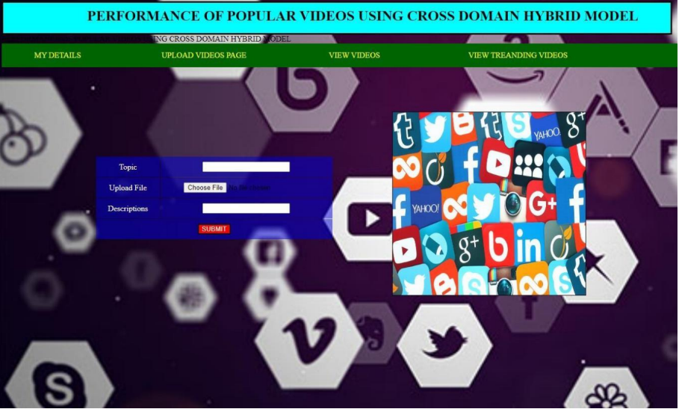
Screenshorts (Results)
Fig 4. Videos Uploading Page

Slide 33
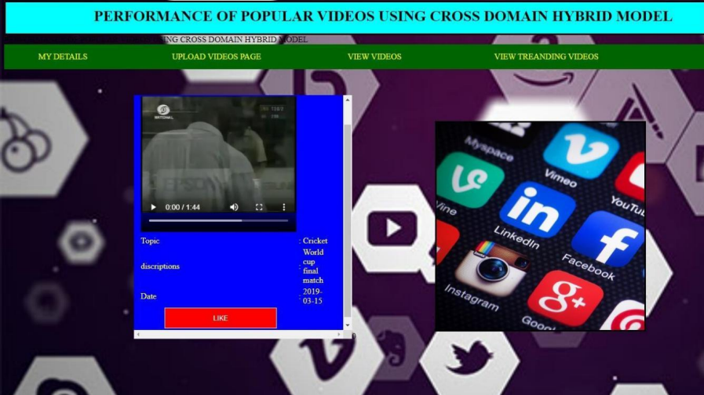
Screenshorts (Results)
Fig 5. Number Of Likes For a Selected Video

Slide 34
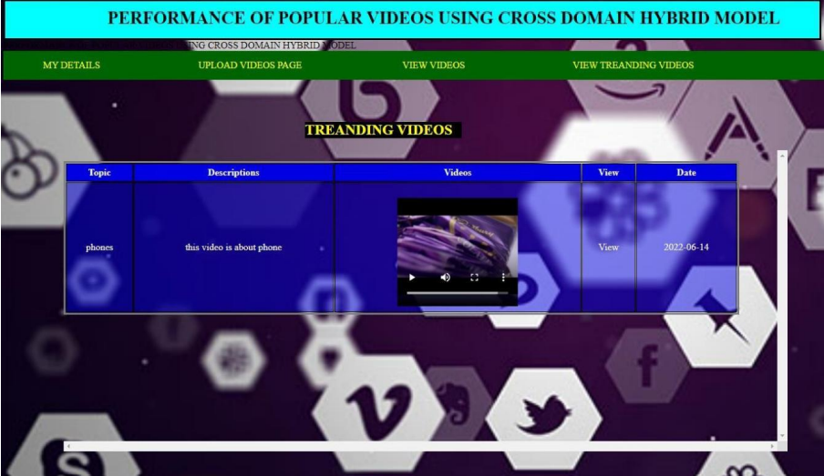
Screenshorts (Results)
Fig 6. Trending Video Page

Slide 35
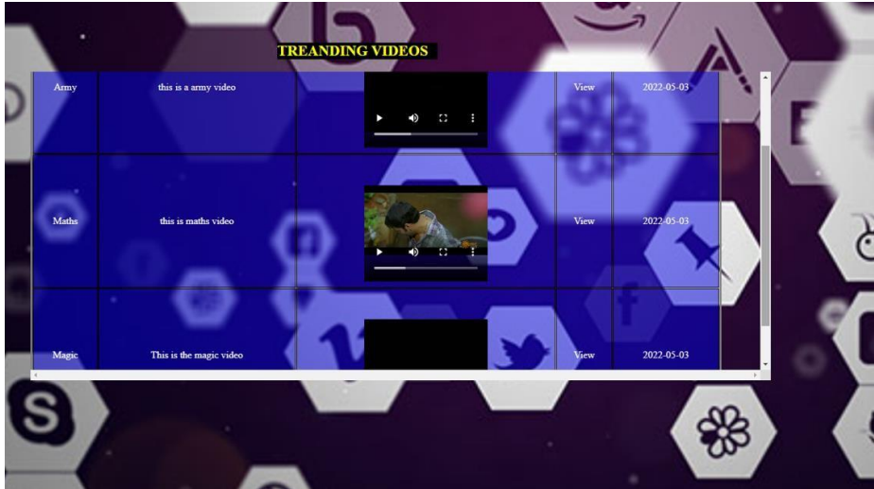
Screenshorts (Results)
Fig 7. Overall Trending videos Page

Slide 36
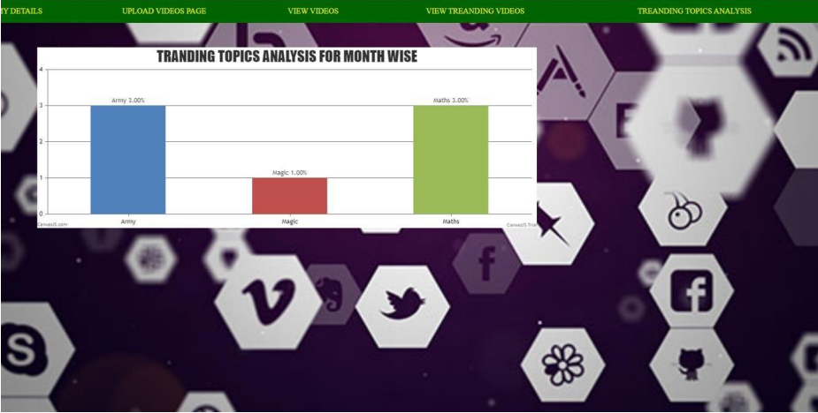
Screenshorts (Results)
Fig 8.Graphical Analysis Of Videos

Slide 37
CONCLUSION
In this project, we have investigated the problem of top-N popular video prediction and have proposed a novel MFDI Prediction model. The proposed model predicts the top-N popular videos by enhancing the ability of early patterns to identify different popularity trends and by optimizing the model’s utilization of multi-source data. Experimental results obtained using real-world data demonstrate that the proposed model outperforms other models, including the state-of-the-art model.

Slide 38
Future Enhancements
This project is our initial study on popularity prediction for Top-N popular videos. To the best of our knowledge, this study is the first popularity prediction research to focus on top-N popular videos. Our study still has room for improvement. Possible improvements include leveraging additional related early features and discovering more precise mathematical correlations between the attitudes of early viewers and future popularity trends. For example, in this study, the early viewers’ attitudes are inferred from only the three explicit behaviour factors; however, early viewers’ attitudes may also be reflected in many implicit ways. If more data related to early viewers’ attitudes or similar features could be well modeled, they would be helpful for further improving the model’s prediction performance, especially on the top-N popular videos.

Slide 39
References
Wan Bai , Yuxiao Zhang “Predicting Movie Popularity Via Cross-Platform Feature Fusion”.
Promod k.Mishra, Indria Priyadarshini “Testing The Impact Of Uncertainity ReviewsIn The Prediction Of Cross Domain Social Media Pages Rating”.
Adam Bielski, Tomasz Trzcinski “Understanding Multimodal Popularity Prediction Of Social Media Video With Self Attention”.
Vikram Singh,Naveen Dahiya “Novel Approach For Predicting Popularity Of User Created Content Using Geographic -Economic And Attention Period Features”.
W. Ding, Y. Shang, L. Guo, X. Hu, R. Yan, and T. He. Video popularity prediction by sentiment propagation via implicit network. In Proceedings of the 24th ACM Internationalon Conference on Information and Knowledge Management, CIKM ’15, pages 1621– 1630, New York, NY, USA, 2015. ACM.

Slide 40
Github link
https://github.com/rohitmoon/top-n-popular-videos-project

Slide 41
THANK YOU

